Slide 1

MACHINE LEARNING
UNIT – III
ENSEMBLE TECHNIQUES
AND UNSUPERVISED LEARNING

Slide 2
COMBINING MULTIPLE LEARNERS
Combining multiple learners is a machine learning technique that combines multiple
models into a single model. The goal is to improve the model's performance by
combining the weak learners in the right way.
Rationale :
• The No Free Lunch Theorem states that there is no single learning algorithm that in any
domain always induces the most accurate learner. The usual approach is to try many and
choose the one that performs the best on a separate validation set.
Different Learners use Different
• Algorithms: making different assumptions
• Hyper parameters: e.g. number of hidden nodes in NN, k in k-NN
• Representations: different features, multiple sources of information
Training sets: small variations in the sets or different subproblems

Slide 3
COMBINING MULTIPLE LEARNERS
Different Algorithms
Different algorithms make different assumptions about the data and lead to
different classifiers.
Different Hyper parameters
Use the same learning algorithm but use it with different hyper parameters.
Different Input Representations
Separate base-learners may be using different representations of the same input object or event, making it possible to integrate different types of Sensors/ measurements/ modalities.
Different representations make different characteristics explicit allowing better identification.
Different Training Sets
Another possibility is to train different base-learners by different subsets of the training set. This can be done randomly by drawing random training sets from the given sample this is called bagging.

Slide 4
COMBINING MULTIPLE LEARNERS
Model Combination Schemes
There are also different ways the multiple base-learners are combined to generate
the final output:
Multi expert combination
Multi expert combination methods have base-learners that work in parallel methods
can in turn be divided into two:
The global approach, also called learner fusion, given an input, all base-learners
generate an output and all these outputs are used.
Examples are voting and stacking.
B) The local approach, or learner selection, for example, in mixture of experts, there
is a gating model, which looks at the input and chooses one (or very few) of the learners
as responsible for generating the output.

Slide 5

COMBINING MULTIPLE LEARNERS
1. Serial Approach:
Next base-learner focuses on instances where previous base-learners are inaccurate.
2. Base Learners:
𝐿: Number of base-learners. 𝑑𝑗(𝑥)d j​ (x): Prediction from base-learner 𝑀𝑗 for input 𝑥.
3. Input Representation:
Each learner 𝑀𝑗M j​ uses a unique input representation 𝑥𝑗x j​ , possibly with transformations.
4. Final Prediction:
Predictions from base-learners are combined using a function: 𝑌=𝑓(𝑑1,𝑑2,…,𝑑𝐿∣Φ)
𝑓(⋅): Combining function. Φ: Parameters of the combining function.
5. Multi-Class Classification:
𝐾: Number of output classes. Each learner 𝑀𝑗 generates 𝐾 predictions, 𝑑𝑗𝑖(𝑥).
Combine predictions to produce final 𝐾 values, 𝑦𝑖.
6. Classification Decision:
Predicted class: Class with the maximum 𝑦𝑖 value is chosen.

Slide 6
COMBINING MULTIPLE LEARNERS
Voting :
• Voting is an ensemble machine learning algorithm that involves making a prediction that is the average (regression) or the sum (classification) of multiple machine learning models.
• A Voting Classifier is a machine learning model that trains on an ensemble of numerous models and predicts an output (class) based on their highest probability of chosen
as the output.
• It simply aggregates the findings of each classifier passed into Voting Classifier and
predicts the output class based on the highest majority of voting.
• The simplest way to combine multiple classifiers is by voting, which corresponds to
taking a linear combination of the learners .
• This is also known as ensembles. In the simplest case, all learners are given equal weight
and simple voting corresponds to take an average.

Slide 7
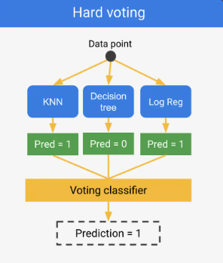
COMBINING MULTIPLE LEARNERS

Slide 8
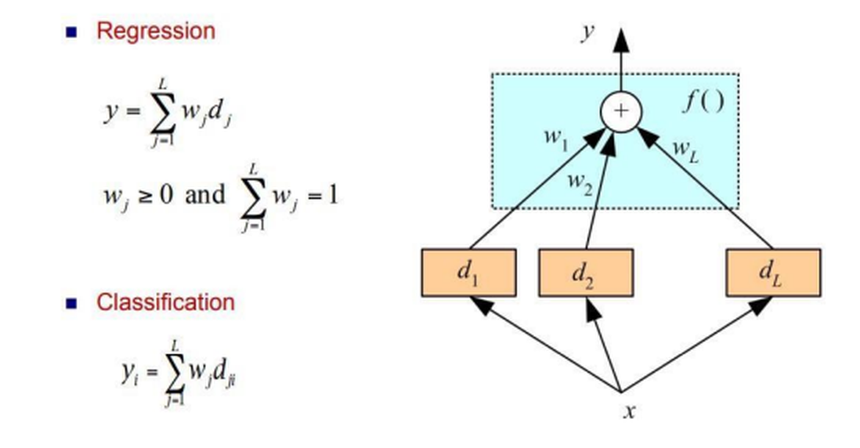
COMBINING MULTIPLE LEARNERS
• Voting Classifier supports two types of voting’s.
2. Detecting Spam Emails
Problem: Classify emails as spam or not spam.
Base Models:
Naive Bayes
Random Forest
Neural Network
Process:
Each model outputs either "Spam" or "Not Spam."
Hard Voting: If two models classify the email as "Spam," the final prediction is "Spam."
Soft Voting: Models assign probabilities, and the final decision is based on the highest probability.
Result: The ensemble is better at detecting spam while minimizing false positives.

Slide 9
COMBINING MULTIPLE LEARNERS
Example:
Detecting Spam Emails :
Problem: Classify emails as spam or not spam.
Base Models:
Naive Bayes
Random Forest
Neural Network
Process:
Each model outputs either "Spam" or "Not Spam."
Hard Voting: If two models classify the email as "Spam," the final prediction is "Spam."
Soft Voting: Models assign probabilities, and the final decision is based on the highest probability.
Result: The ensemble is better at detecting spam while minimizing false positives.

Slide 10
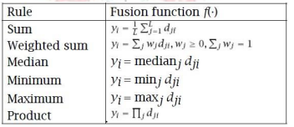
COMBINING MULTIPLE LEARNERS
Hard Voting:
Predicts the class with the highest majority of votes from classifiers.
Example: If three classifiers predict (A, A, B), the majority is A,becomes the final prediction.
2. Soft Voting:
Predicts the class based on the average probability assigned by classifiers.
Example:
Class A probabilities: (0.30, 0.47, 0.53) → Average = 0.4333.
Class B probabilities: (0.20, 0.32, 0.40) → Average = 0.3067.
Winner: Class A due to higher average probability.
3. Bayesian Interpretation:
Voting schemes approximate a Bayesian framework
Classifier weights represent prior model probabilities, and model decisions approximate conditional likelihoods.

Slide 11

COMBINING MULTIPLE LEARNERS
Bayesian model combination:
Different Algorithms
Different algorithms make different assumptions about the data and lead to
different classifiers.
Different Hyper parameters
Use the same learning algorithm but use it with different hyper parameters.
Different Input Representations
Separate base-learners may be using different representations of the same input object or event, making it possible to integrate different types of Sensors/ measurements/ modalities.
Different representations make different characteristics explicit allowing better identification.
Different Training Sets
Another possibility is to train different base-learners by different subsets of the training set. This can be done randomly by drawing random training sets from the given sample this is called bagging.

Slide 12
ENSEMBLE LEARNING TECHNIQUE
Ensemble learning Technique :
"An ensembled model is a machine learning model that combines the predictions from two or
more models.”
• Ensemble learning is one of the most powerful machine learning techniques that use the combined output of two or more models/weak learners and solve a particular computational intelligence problem.
• E.g., a Random Forest algorithm is an ensemble of various decision trees combined.
• Ensemble learning is primarily used to improve the model performance, such as classification, prediction, function approximation, etc.
Simple Ensemble Training Methods typically just involve the application of statistical summary techniques, such as determining the mode, mean, or weighted average of a set of predictions.

Slide 13
ENSEMBLE LEARNING TECHNIQUE
Advanced Ensemble Training Methods :
• Bagging: Bagging is a method used to solve supervised machine learning problems.
• Boosting: Boosting is an ensemble method that enables each member to learn from the
preceding member's mistakes and make better predictions for the future.
• Stacking: Stacking is one of the popular ensemble modeling techniques in machine learning. Weak learners are ensembled in a parallel manner in that by combining them with Meta learners, we can predict better predictions for the future
Ensemble learning methods can be divided into one of two different groups:
1. Sequential methods
• Base learners/models are generated sequentially, the dependence between the base learners is exploited to get more accurate predictions. Eg: AdaBoost, XGBoost, and Gradient tree boosting.

Slide 14
ENSEMBLE LEARNING TECHNIQUE
Bagging Technique in Ensemble Learning :
Bagging is primarily used to solve supervised machine learning problems. Classified into:
• Bootstrapping: Random sampling method that is used to derive samples from the data
using the replacement procedure. First, random data samples are fed to the primary model, and then a base learning algorithm is run on the samples to complete the learning process.
• Aggregation: The process of combining the output of all base models and, based on their output, predicting an aggregate result with greater accuracy and reduced variance.
• Example: In the Random Forest method, predictions from multiple decision trees are ensembled parallelly. Further, in regression problems, we use an average of these predictions to get the final output, whereas, in classification problems, the model is selected as the predicted class.

Slide 15
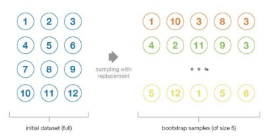
DECISION TREE
Implementation Steps of Bagging :
• Step 1: Multiple subsets are created from the original data set with equal tuples, selecting observations with replacement.
• Step 2: A base model is created on each of these subsets.
• Step 3: Each model is learned in parallel with each training set and independent of each other. • Step 4: The final predictions are determined by combining the predictions from all the models.

Slide 16
DECISION TREE
Boosting Technique in Ensemble learning :
• Boosting enables each member to learn from the preceding member's mistakes and make better predictions for the future.
• It is done by building a model by using weak models in series.
• Firstly, a model is built from the training data.
• Then the second model is built which tries to correct the errors present in the first model.
• This procedure is continued and models are added until either the complete training data set is predicted correctly or the maximum number of models is added.
• AdaBoost is short for Adaptive Boosting and is a very popular boosting technique that combines multiple “weak classifiers” into a single “strong classifier”.

Slide 17
DECISION TREE
Algorithm :
1. Initialize the dataset and assign equal weight to each of the data point.
2. Provide this as input to the model and identify the wrongly classified data points.
3. Increase the weight of the wrongly classified data points and decrease the
weights of correctly classified data points. And then normalize the weights of all
data points.
4. if (got required results)
Goto step 5
else
Goto step 2

Slide 18
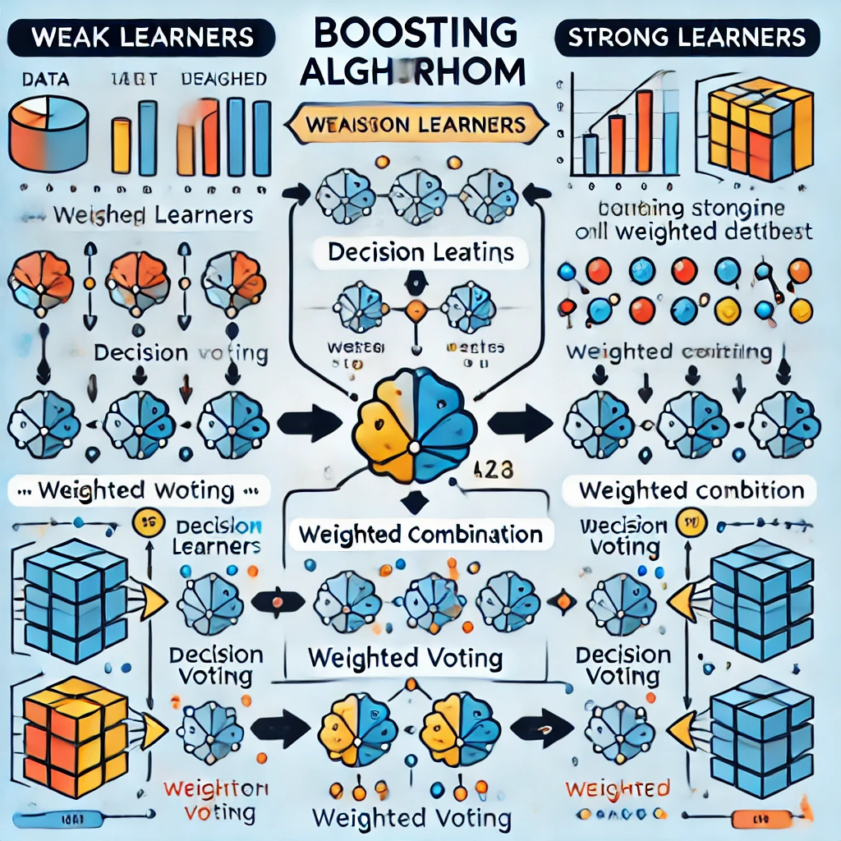
DECISION TREE
Fig. An illustration of the boosting algorithm, consisting of the parallel learners weighted dataset.

Slide 19
DECISION TREE
Similarities Between Bagging and Boosting
1. Both are ensemble methods to get N learners from 1 learner.
2. Both generate several training data sets by random sampling.
3. Both make the final decision by averaging the N learners (or taking the majority
of them i.e Majority Voting).
4. Both are good at reducing variance and provide higher stability.
Differences between Bagging and Boosting
Bagging Boosting
The simplest way of combining predictions • A way of combining predictions that
that belong to the same type. belong to the different types.
Aim to decrease variance, not bias • Aim to decrease bias, not variance.
Each model receives equal weight. • Weighted based on performance.
Each model is built independently. • Influenced by of previously built model

Slide 20
DECISION TREE
Algorithm :
1. Initialize the dataset and assign equal weight to each of the data point.
2. Provide this as input to the model and identify the wrongly classified data points.
3. Increase the weight of the wrongly classified data points and decrease the
weights of correctly classified data points. And then normalize the weights of all
data points.
4. if (got required results)
Goto step 5
else
Goto step 2
Figure 3.4 An illustration presenting the intuition behind the boosting algorithm,
consisting of the parallel learners and weighted dataset.

Slide 21
DECISION TREE
Stacking
• Stacking is one of the popular ensemble modeling techniques in machine learning. Various weak learners are ensembled in a parallel manner in such a way that by combining them with Meta learners, we can predict better predictions for the future.
• This ensemble technique works by applying input of combined multiple weak learners' predictions and Meta learners so that a better output prediction model can be achieved.
• In stacking, an algorithm takes the outputs of sub-models as input and attempts to learn how to best combine the input predictions to make a better output prediction.
• Stacking is also known as a stacked generalization and is an extended form of the Model Averaging Ensemble technique in which all sub-models equally participate as per their performance weights and build a new model with better predictions. This new model is stacked
up on top of the others; this is the reason why it is named stacking.

Slide 22
DECISION TREE
The basic architecture of stacking can be represented as :
o Original data: This data is divided into n-folds and is also considered test
data or training data.
o Base models: These models are also referred to as level-0 models. These
models use training data and provide compiled predictions (level-0) as an
output.
o Level-0 Predictions: Each base model is triggered on some training data and
provides different predictions, which are known as level-0 predictions.
o Meta Model: The architecture of the stacking model consists of one metamodel, which helps to best combine the predictions of the base models. The meta-model is also known as the level-1 model.

Slide 23
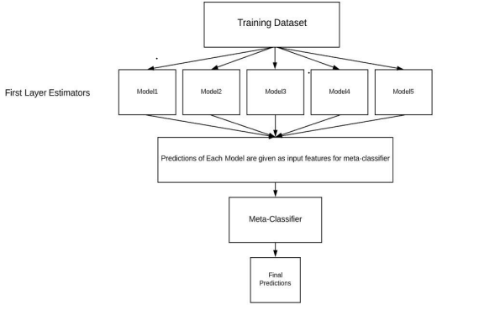
DECISION TREE
Level-1 Prediction: The meta-model learns how to best combine the predictions of the base models and is trained on different predictions made by individual base models, i.e., data not used to train base models are fed to
meta-model, predictions are made, and these predictions, along with the expected outputs, provide the input and output pairs of the training dataset used to fit the meta-model

Slide 24
DECISION TREE
Steps to implement Stacking models:
o Split training data sets into n-folds using the Repeated Stratified KFold as this is the most common approach to preparing training datasets for metamodels.
o Base model is fitted with the first fold, which is n-1, and it will make predictions for nth folds.
o The prediction made in the above step is added to the x1_train list.
o Repeat steps 2 & 3 for remaining n-1folds, so it will give x1_train array of size n.
o Model is trained on all the n parts, which will make predictions for the sample data.
o Add this prediction to the y1_test list.
o In the same way, we can find x2_train, y2_test, x3_train, and y3_test by using
Model 2 and 3 for training, respectively, to get Level 2 predictions.
o Now train the Meta model on level 1 prediction, where these predictions will
be used as features for the model (refer Figure 4.3).
o Meta learners can now be used to make a prediction on test data in the stacking model

Slide 25
UNSUPERVISED LEARNING
Unsupervised learning is a type of machine learning in which models are trained using unlabeled dataset and are allowed to act on that data without any supervision.
Clustering
• Clustering or cluster analysis is a machine learning technique, which groups
the unlabeled dataset.
• It is "A way of grouping the data points into different clusters, consisting of
similar data points. The objects with the possible similarities remain in a
group that has less or no similarities with another group.“
• Clustering involves dividing data points into multiple clusters of similar values.
• Cluster is a group of objects that belongs to the same class

Slide 26
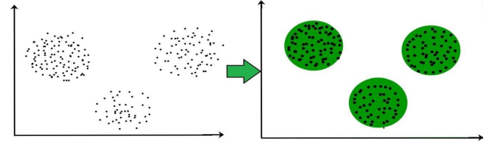
UNSUPERVISED LEARNING
Clustering is a process of partitioning a set of data in a meaningful subclass as shown in fig.

Slide 27
UNSUPERVISED LEARNING
Common uses of this technique are:
Market Segmentation
Statistical data analysis
Social network analysis
Image segmentation
Anomaly detection, etc.
Types of Clustering Methods
Hard clustering (datapoint belongs to only one group)
Soft Clustering (data points can belong to another group also).

Slide 28
UNSUPERVISED LEARNING
Main clustering methods used in Machine learning:
Partitioning Clustering
Density-Based Clustering
Distribution Model-Based Clustering
Hierarchical Clustering
Fuzzy Clustering
Partitioning Clustering
It is a type of clustering that divides the data into non -hierarchical
groups.
It is also known as the centroid-based method.
Most common example of partitioning clustering is the K-Means clustering algorithm

Slide 29
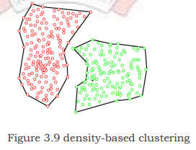
UNSUPERVISED LEARNING
Density-Based Clustering
• The density-based clustering method connects the highly-dense areas into clusters, and the arbitrarily shaped distributions are formed as long as the dense region can be connected.
• This algorithm does it by identifying different clusters in the dataset and connects the areas of high densities into clusters.
• The dense areas in data space are divided from each other by sparser areas

Slide 30
UNSUPERVISED LEARNING
Distribution Model-Based Clustering :
• In the distribution model-based clustering method, the data is divided based on the probability of how a dataset belongs to a particular distribution.
The grouping is done by assuming some distributions commonly Gaussian Distribution.
• The example of this type is the Expectation-Maximization Clustering
algorithm that uses Gaussian Mixture Models (GMM) as shown in
In this technique, the dataset is divided into clusters to create a tree - like structure, which is also called a dendrogram.
The observations or any number of clusters can be selected by cutting the tree at the correct level.
The most common example of this meth od is the Agglomerative
Hierarchical algorithm

Slide 31
UNSUPERVISED LEARNING
Common uses of this technique are:
Market Segmentation
Statistical data analysis
Social network analysis
Image segmentation
Anomaly detection, etc.
Types of Clustering Methods
Hard clustering (datapoint belongs to only one group)
Soft Clustering (data points can belong to another group also).

Slide 32
UNSUPERVISED LEARNING
Main clustering methods used in Machine learning:
Partitioning Clustering
Density-Based Clustering
Distribution Model-Based Clustering
Hierarchical Clustering
Fuzzy Clustering
Partitioning Clustering
It is a type of clustering that divides the data into non –hierarchical groups.
It is also known as the centroid-based method.
The most common example of partitioning clustering is the K-MeansClustering algorithm

Slide 33
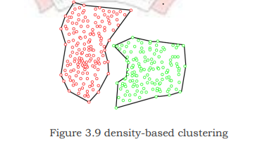
UNSUPERVISED LEARNING
Density-Based Clustering
• The density-based clustering method connects the highly-dense areas
into clusters, and the arbitrarily shaped distributions are formed as
long as the dense region can be connected.
• This algorithm does it by identifying different clusters in the dataset
and connects the areas of high densities into clusters.
• The dense areas in data space are divided from each other by sparser
areas

Slide 34
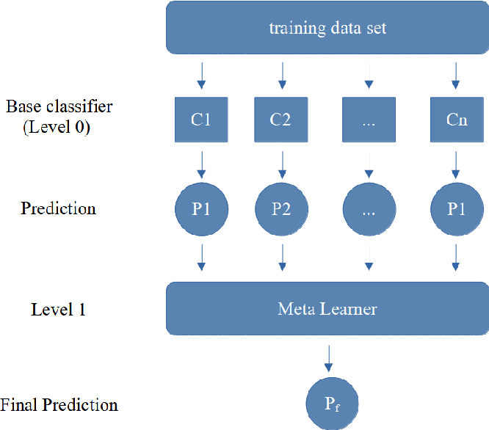
UNSUPERVISED LEARNING
Distribution Model-Based Clustering
• In the distribution model-based clustering method, the data is divided based on the
probability of how a dataset belongs to a particular distribution.
The grouping is done by assuming some distributions commonly .
• The example of this type is the Expectation-Maximization
Clustering algorithm that uses Gaussian Mixture Models shown
• In this technique, the dataset is divided into clusters to
create a tree - like structure, which is also called a dendrogram.
• The observations or any number of clusters can be selected
by cutting tree at the correct level.
• The most common example of this method is the
Agglomerative Hierarchical algorithm

Slide 35
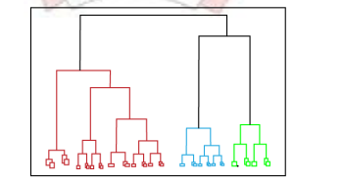
UNSUPERVISED LEARNING
Hierarchical Clustering:
1. Fuzzy Clustering:
Fuzzy clustering is a type of soft method in which a data object
May belong to more than one group or cluster.
• Each dataset has a set of membership coefficients, which
depend on the degree of membership to be in a cluster.
• Fuzzy C-means algorithm is the example of this type of
Clustering sometimes also known as the Fuzzy k-means algorithm.
Clustering Algorithms
• K-Means algorithm • Mean-shift algorithm • Affinity Propagation
• Expectation-Maximization Clustering using GMM • Agglomerative Hierarchical algorithm
• DBSCAN Algorithm-Density-Based Spatial Clustering of Applications with Noise.

Slide 36




UNSUPERVISED LEARNING
Working of K-Means Algorithm :
The working of the K-Means algorithm is explained in the below steps:
1. Choose the value of k and the k initial guesses for the centroids.
2. Compute the distance from each data point to each centroid. In two dimensions, the distance, d, between any two points, (X1, Y1) and (X2, Y2), in the Cartesian plane is typically expressed by using the Euclidean distance measure provided in
3. Compute the centroid, the center of mass, of each newly defined cluster from Step2.
In two dimensions, the centroid (Xc, Yc) of the m points in a k-means cluster is calculated as
follows in
4. Calculate distance d, between pi and q. For a point, pi, at (pi1, pi2, . . . pin), a centroid q, located at (q1, q2, . . . qn), the distance, d, between pi and q, is expressed as
5. Calculate centroid, q. The centroid, q, of a cluster of m points,
(pi1, pi2, . . . pin) , is calculated

Slide 37
INSTANCE BASED LEARNING
Instance based learning:
• The systems that learn the training examples by heart and then generalizes to new instances based on some similarity measure, also called memory-based learning or lazy-learning.
• It is called instance-based because it builds the hypotheses from the training instances.
• It is also known as • When a new instance is encountered, its relationship to the stored examples is examined in order to assign a target function value for the new instance.
• Instance-based methods are sometimes referred to as lazy learning methods because they delay processing until a new instance must be classified.
• Instead of estimating the target function once for the entire instance space, these methods can estimate it locally and differently for each new instance to be classified.
• Some of the instance-based learning algorithms are:
o K Nearest Neighbor (KNN) o Self-Organizing Map (SOM) o Learning
Vector Quantization (LVQ) o Locally Weighted Learning (LWL) o Case Based Reasoning

Slide 38
K-NEAREST NEIGHBOR LEARNING - KNN
o k-Nearest Neighbor Learning - KNN is one of the simplest Machine Learning algorithms based on Supervised Learning technique.
o K-NN algorithm assumes the similarity between the new case/data and available cases and put the new case into the category that is most similar to the available categories.
o K-NN algorithm can be used for Regression as well as for Classification but mostly it is used for the Classification problems.
o K-NN is a non-parametric algorithm, which means it does not make any assumption on underlying data. o It is also called a lazy learner algorithm because it does not learn from
the training set immediately instead it stores the dataset and at the time of classification, it performs an action on the dataset.
o KNN algorithm at the training phase just stores the dataset and when it gets new data, then it classifies that data into a category that is much similar to the new data.

Slide 39
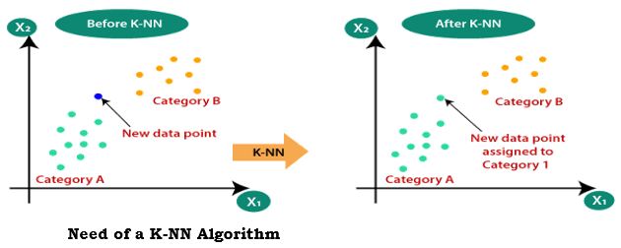
K-NEAREST NEIGHBOR LEARNING - KNN
Suppose there are two categories, i.e., Category A and Category B, and we have a new data point x1, so this data point will lie in which of these categories. To solve this type of problem, we need a K -NN algorithm. With the help of K -NN, we can easily identify the category or class of a particular dataset. Consider the below diagram:

Slide 40
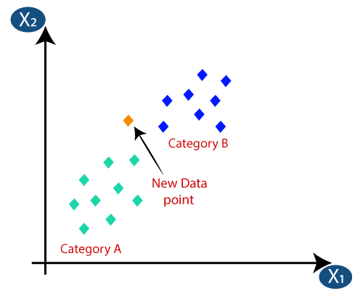
K-NEAREST NEIGHBOR LEARNING - KNN
How does K-NN work?
The K-NN working can be explained on the basis of the below algorithm:
Step-1: Select the number K of the neighbors
Step-2: Calculate the Euclidean distance of K number of neighbors
Step-3: Take the K nearest neighbors as per the calculated Euclidean distance.
Step-4: Among these k neighbors, count the number of the data points in each category.
Step-5: Assign the new data points to that category for which the number of the neighbor is maximum.
Step-6: Our model is ready.
Suppose we have a new data point
and we need to put it in the required
category. Consider the below image:

Slide 41
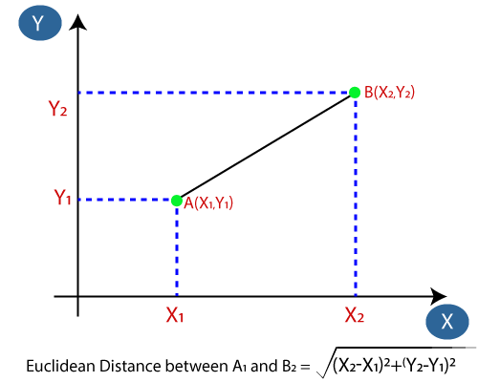
K-NEAREST NEIGHBOR LEARNING - KNN
Firstly, we will choose the number of neighbors, so we will choose the k=5.
Next, we will calculate the Euclidean distance between the data points. The Euclidean distance is the distance between two points, which we have already studied in geometry. It can be calculated as:

Slide 42
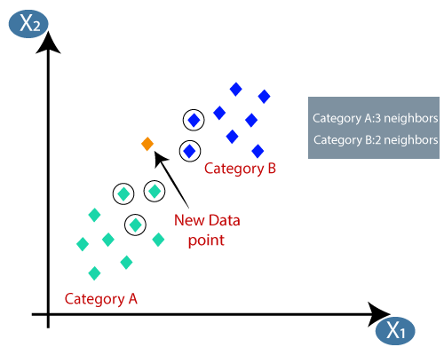
K-NEAREST NEIGHBOR LEARNING - KNN
By calculating the Euclidean distance we got the nearest neighbors, as three nearest neighbors in category A and two nearest neighbors in category B. Consider the below image:

Slide 43
K-NEAREST NEIGHBOR LEARNING - KNN
Advantages of KNN Algorithm:
It is simple to implement.
It is robust to the noisy training data
It can be more effective if the training data is large.
Disadvantages of KNN Algorithm:
Always needs to determine the value of K which may be complex some time.
The computation cost is high because of calculating the distance between the data points for all the training samples.

Slide 44
K-NEAREST NEIGHBOR LEARNING - KNN
Python implementation of the KNN algorithm :
To do the Python implementation of the K-NN algorithm, we will use the same problem and dataset which we have used in Logistic Regression. But here we will improve the performance of the model. Below is the problem description:
Problem for K-NN Algorithm: There is a Car manufacturer company that has manufactured a new SUV car. The company wants to give the ads to the users who are interested in buying that SUV. So for this problem, we have a dataset that contains multiple user's information through the social network. The dataset contains lots of information but the Estimated Salary and Age we will consider for the independent variable and the Purchased variable is for the dependent variable. Below is the dataset:

Slide 45
K-NEAREST NEIGHBOR LEARNING - KNN
Advantages of KNN Algorithm:
It is simple to implement, robust to the noisy training data
It can be more effective if the training data is large.
Disadvantages of KNN Algorithm:
Always needs to determine the value of K which may be complex some time.
The computation cost is high as calculating the distance between the data points for all the training samples.’
Steps to implement the K-NN algorithm:
Data Pre-processing step
Fitting the K-NN algorithm to the Training set
Predicting the test result
Test accuracy of the result(Creation of Confusion matrix)
Visualizing the test set result.

Slide 46
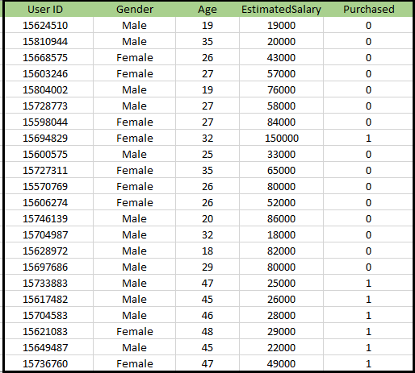
K-NEAREST NEIGHBOR LEARNING - KNN
Test Example:
Gender: Male,
Age: 30, Salary: 60,000
Goal: Predict "Purchased" (0 or 1).
2. Steps in KNN:
Choose K (e.g., 𝐾=5K=5).
Calculate Euclidean distance between test example and all training points.
Find the K closest neighbors.
Count neighbors in each class (Purchased = 0 or 1).
Assign the class with the majority vote.
3. Example Prediction:
Nearest neighbors:
3 (Purchased = 0),
2 (Purchased = 1).
Prediction: Purchased = 0.

Slide 47
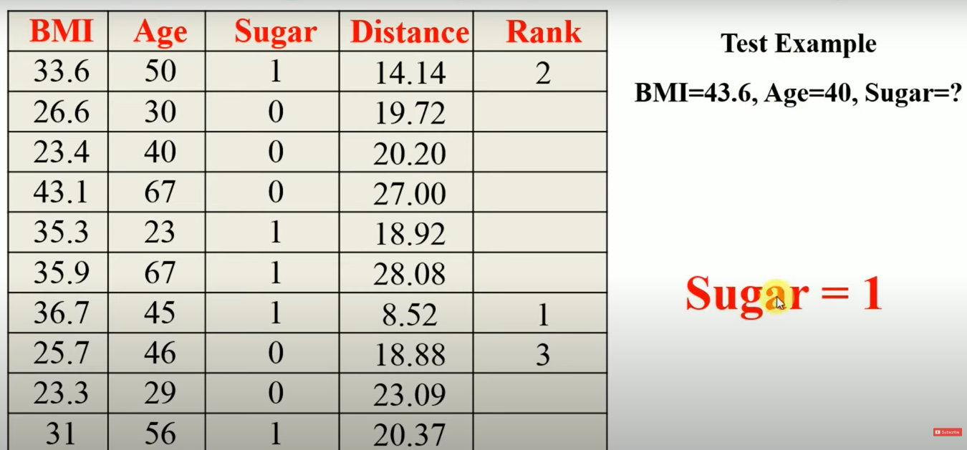
K-NEAREST NEIGHBOR LEARNING - KNN

Slide 48
GAUSSIAN MIXTURE MODEL
Gaussian mixture models (GMMs) are a type of machine learning algorithm.
They are used to classify data into different categories based on the probability distribution.
• Gaussian mixture models can be used in many different areas, including finance, marketing and so much more.
• The Gaussian mixture model is a probabilistic model that assumes all the data points are generated from a mix of Gaussian distributions with unknown parameters.
• A Gaussian mixture model can be used for clustering, which is the task of grouping a set of data points into clusters.
• In general, K-means will be faster and more accurate when the data set is large and the clusters are well-separated. Gaussian mixture models will be more accurate when the data set is small or the clusters are not well separated.
• GMM consists of two parts – mean vectors (μ) & covariance matrices (Σ).

Slide 49

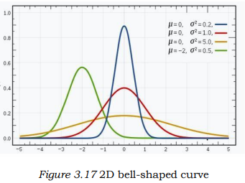
GAUSSIAN MIXTURE MODEL
A Gaussian distribution is defined as a continuous probability distribution that takes on a bell-shaped curve. Another name for Gaussian distribution is the normal distribution
• Gaussian mixture models can handle missing data, whereas K-means cannot.
In the case of two variables, instead of a 2D bell-shaped curve, we will have 3D bell curve
covariance matrix.
• Probability density function for one dimensional space of a Gaussian distribution is given by:
where μ is the mean and
is the variance
• In case of two variables, instead of
a 2D bell-shaped curve, we will have
a 3D bell curve

Slide 50
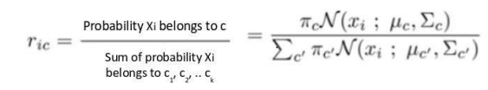
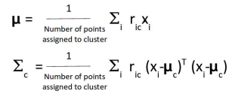
GAUSSIAN MIXTURE MODEL
E-step:
For each point x i, calculate the probability that it belongs to cluster/distribution c 1, c 2, … c k. This is done using the below formula:
This value will be high when the point is
assigned to the right cluster and lower otherwise.
M-Step:
Update Density: Calculate cluster density
as the fraction of points in the cluster out of the total points.
Update Mean and Covariance: Adjust mean and covariance
based on probabilities of points belonging to the cluster
(higher probability = greater influence).

Slide 51
THANK YOU…

